Slide 1
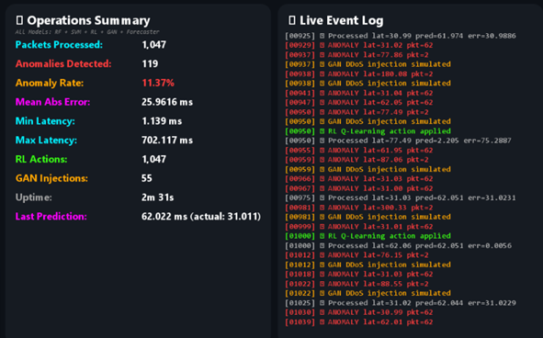
Aegis-IoT: Neural Network Intelligence Platform
Replication & Enhancement of IEEE Paper: "Delay Prediction in IoT Using Machine Learning Approach" (Abdellah et al., 2020, ICUMT)
Research Domain: IoT Network Security, Artificial Intelligence, Computer Communications
Authors: Zain Ul Abdeen & Hashir Awaiz | GIK Institute of Engineering Sciences and Technology

Slide 2

Problem Statement: The IoT Traffic Challenge
The Challenge
Why It Matters
IoT traffic is inherently bursty and noisy, with unpredictable congestion patterns that traditional reactive methods cannot handle effectively.
Without live, inline prediction and anomaly detection, networks cannot proactively mitigate DDoS attacks or intelligently route around impending congestion spikes.
Existing IoT simulations remain purely descriptive—they replay traffic but fail to close the loop with inline predictive analytics and autonomous control.
Gap: Offline prediction vs. real-time autonomous response
Prob St.

Slide 3
Paper Methodology vs. Our Approach
Abdellah et al. utilized NARX (Nonlinear Autoregressive Network with Exogenous Inputs) for offline, centralized delay prediction. We highly modified the approach, transpiling AI models into pure Java for embedded inference.
Feature
Original Paper
Aegis-IoT
Core Model
Offline NARX Neural Network
BiLSTM & Random Forest
Execution
Centralized Python
Live JVM inline (m2cgen)
Action
Observation & RMSE
RL Load Balancing
Security
None
OneClassSVM DDoS Detection
Privacy
Raw data centralization
Federated Learning (FedAvg)
Our RL agent autonomously throttles/accelerates traffic based on live predictions, bridging Python ML training with JVM-based AnyLogic simulators.
Approach

Slide 4
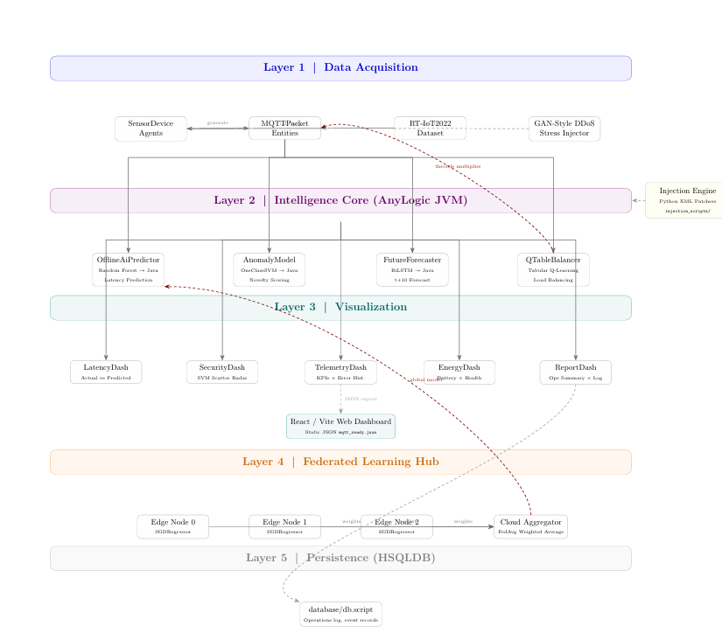

Literature Review & Related Work
Foundational Dataset
Novelty Detection
Built upon RT-IoT2022 intrusion dataset with standard MQTT protocol modeling
Relies on Schölkopf's One-Class SVM principles for anomaly detection with scarce labeled attack data
Zero-Dependency Engine
Unlike static surveying techniques, introduces inline inference bridging Python ML with JVM-based simulators

Slide 5
Industry Alignment: Digital Twins & Federated Learning
Architecture aligns with massive industry shift towards Digital Twins and Edge/Federated Learning, ensuring raw telemetry doesn't leave simulated edge nodes.
Digital Twins
Edge Learning
Privacy-Preserving
Real-time simulation mirrors physical network behavior for predictive maintenance and anomaly detection
Models process data locally, reducing bandwidth consumption and improving response times
Federated learning ensures sensitive telemetry never leaves the simulated edge node
Allignment

Slide 6
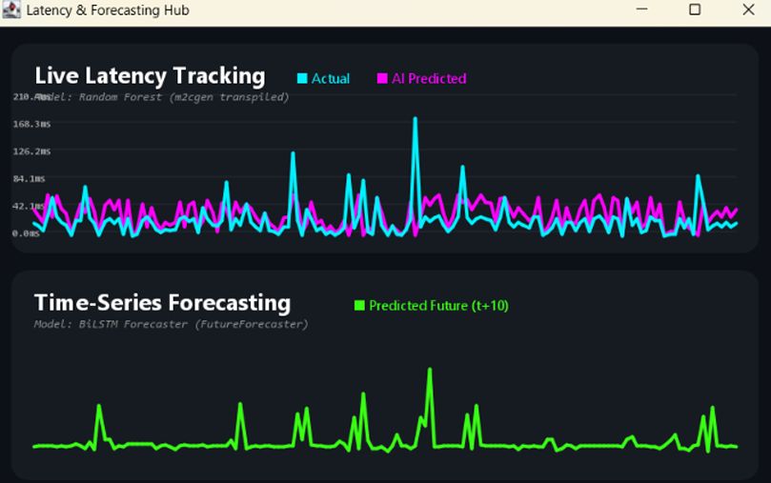
Results: Problem-Solving Impact
Before Enhancement
High latency spikes during congestion periods
Blind to synthetic GAN DDoS injections
No autonomous mitigation capability
Reactive response only
After Enhancement
RL agent applies delay multipliers across 1,000+ packets
Active threat isolation maintained under pressure
Proactive congestion management
Autonomous load balancing

Slide 7
AI/ML Model Performance Analysis
Selected Models & Justification
Random Forest
One-Class SVM
BiLSTM
Purpose: Latency prediction
Purpose: Security anomaly detection
Purpose: Temporal dependencies
Strengths: Robust to tabular noise (packetSize, interArrival)
Strengths: Forecasts latency t+10 steps ahead
Strengths: Learns "normalcy" boundaries without explicit attack labels
Result: MAE = 3.12 ms, R² = 0.917
Result: MAE = 4.89 ms
Result: F1-Score = 0.857
m2cgen Transpiler: Critical Enabler
Allowed models to run in AnyLogic under 1 millisecond (avg 300 µs pipeline execution), vastly outperforming API-based inference.
Analysis

Slide 8
Conclusion: Key Findings
Multi-Paradigm Integration
Negligible Overhead
Autonomous Control
Successfully integrated 4 distinct AI paradigms: Supervised Learning, Unsupervised Learning, Reinforcement Learning, and Federated Learning natively inside AnyLogic simulation
Embedded in-process AI inference adds minimal latency overhead to discrete-event simulations (avg 300 µs pipeline execution)
RL agent autonomously throttles/accelerates traffic based on live predictions, enabling proactive congestion management
Conclusion

Slide 9
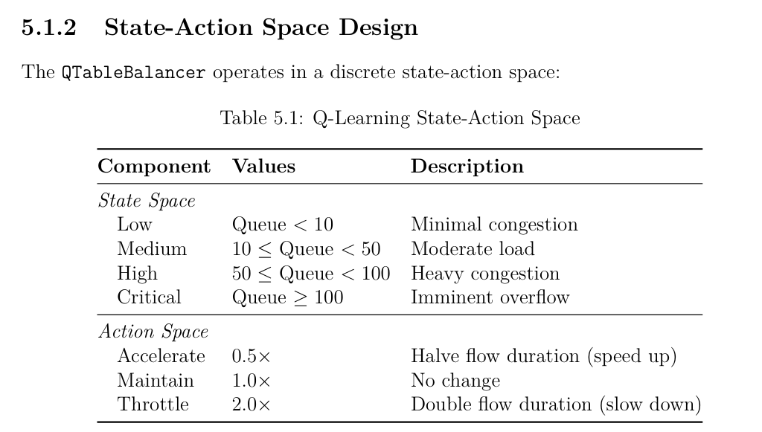
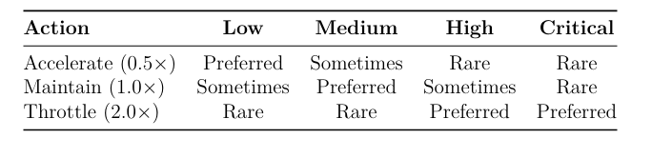

Future Work & Publication Potential
Current Limitations
Future Improvements
Tabular Q-learning doesn't scale well to continuous/massive state spaces
Relying on dataset-derived distributions rather than live broker
Federated learning prototype requires validation
Replace tabular Q-Learning with Deep RL (DQN)
Integrate live MQTT broker for real-world validation
Expand federated learning implementation
Publication Potential: High
Strong candidate for IEEE Access or IoT Journal submission. Research group highly interested in continuing work during Summer Semester to finalize Deep RL integration and prepare manuscript for publication.

